Slide 1
Comparison research between XY and ODD-Even Routing Algorithm of a 2-Dimension 3x3 Mesh Topology
Project Members Dhaman Kumar Kakke CH.V.S Bhargava Reddy

Slide 2
Contents
Introduction
Overview of NOC DESIGN APPROACH
XY AND OE ROUTING ALGORITHM
ARCHITECTURE OF A 2-DIMENTION 3X3 MESH TOPOLOGY NOC
SIMULATION RESULTS AND ANALYSIS
CONCLUSION
REFERENCES

Slide 3
INTRODUCTION
NOC has been recognized as a paradigm to solve System –on- Chip (SoC) design challenges.
Routing algorithm is one of the key research of NoC design
XY routing algorithm – Distributed Deterministic Routing Algorithm
ODD-EVEN algorithm – Complex Distributed adaptive Routing Algorithm

Slide 4
Introduction
The main task of a network layer design is it defines the path taken by the packet between the source and the destination
It is possible to clarify routing source and distributed routing .
Deterministic routing – path is uniquely defined by the source and target address.

Slide 5
Overview of NOC Design approach
Designers view SoC as a micro –network of components
The data-link layer abstracts the physical layer as an unreliable digital link
The Protocol Stack from which the stack paradigm of network on chip can be adapted (Diagram)

Slide 6
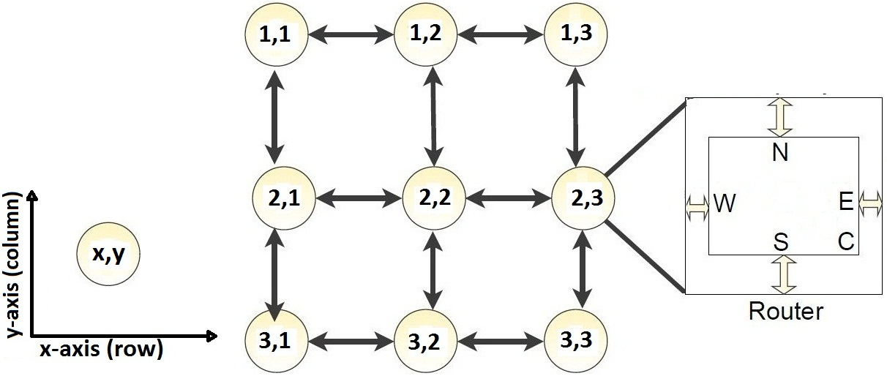
XY ROUTING ALGORITHM

Slide 7
ODD-EVEN ROUTING ALGORITHM

Slide 8
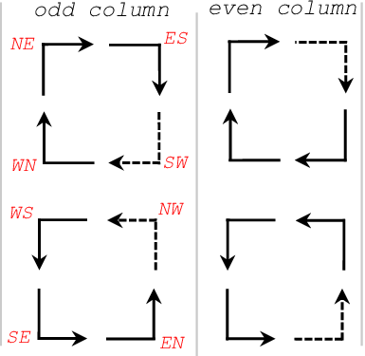
Restricted Turns

Slide 9
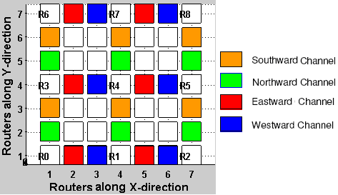
ARCHITECTURE FOR SIMULATION

Slide 10
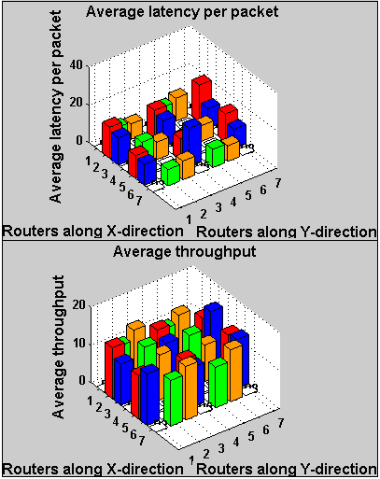
Average latency per packet and Average throughput statistical histogram of XY routing algorithm

Slide 11
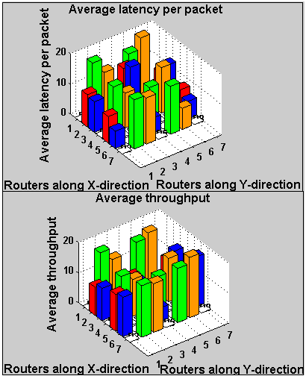
AVERAGE LATENCY PER PACKET AND AVERAGE THROUGHPUT STATISTICAL HISTOGRAM OF OE ROUTING ALGORITHM BASED ON A 2-D 3X3 MESH TOPOLOGY NOC

Slide 12
KEY PERFORMANCE SIMULATION PARAMETERS OF XY ROUTING ALGORITHM AND OE ROUTING ALGORITHM
 |  | MIAX OF CHANNEL | MIN OF CHANNEL | AVERAGE OF NETWORK
XY | LATENCY PER PACKET (CLOCK CYCLES) | 20.5 | 7.3 | 13.6
 | THROUGHPUT | 15.5 | 9.6 | 11.7
OE | LATENCY PER PACKET (CLOCK CYCLE) | 19.5 | 5.0 | 11.9
 | THROUGHPUT(GBPS) | 20.0 | 4.5 | 13.0

Slide 13
CONCLUSION
Performance of XY algorithm P(XY)=0.86
Performance of ODD-EVEN algorithm P(OE)=1.09
P(OE) > P(XY)

Slide 14
References
https://libproxy.library.unt.edu:2301/document/5209133

